Slide 1
KurrentDB
Lecturer: Ngo Huy Bien
Software Engineering Department
Faculty of Information Technology
VNUHCM - University of Science
Ho Chi Minh City, Vietnam
nhbien@fit.hcmus.edu.vn

Slide 2

Objectives
To install and start EventStoreDB.
To write data to EventStoreDB.
To read data from EventStoreDB.

Slide 3

Contents
EventStoreDB

Slide 4

References

Slide 5
KurrentDB
https://docs.kurrent.io/getting-started/introduction.html
KurrentDB is an event-native database designed specifically to store, process, and deliver application state changes, known as events.
Each event captures a specific change in the state. Examples include when an order is placed, a payment is processed, or an item is shipped. By capturing all these incremental updates, KurrentDB captures temporal context and provides a complete audit trail of a business process.

Slide 6
Why KurrentDB?
https://docs.kurrent.io/getting-started/introduction.html
Traditional databases often focus only on current state and overwrite data, which discards valuable information about the past and the events that shaped the current state.
In contrast, KurrentDB keeps a complete history of changes, providing organizations with richer, and more contextual data that supports deeper insights - critical in today’s AI and data-driven environment.
KurrentDB also includes additional features that make it simple to develop event-native applications that enable real-time updates and minimize system dependencies while maintaining data consistency.

Slide 7
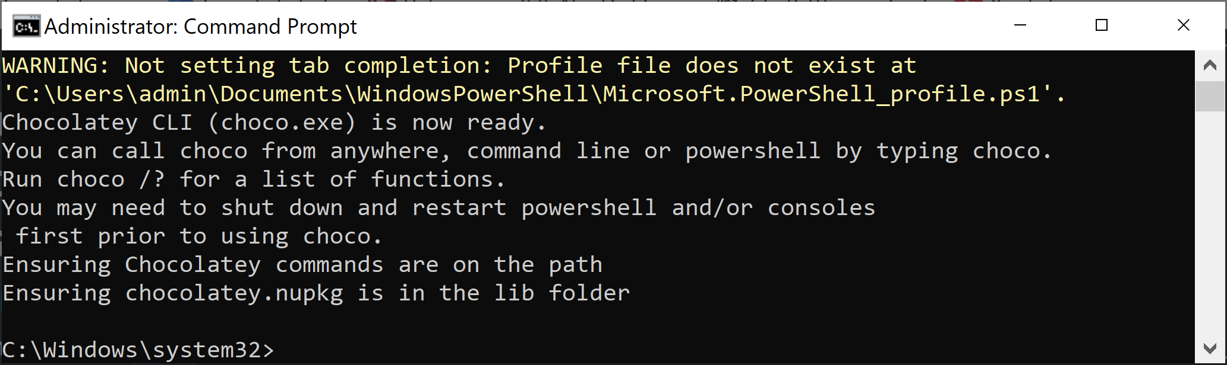
1. Install Chocolatey
https://docs.chocolatey.org/en-us/choco/setup/
@"%SystemRoot%\System32\WindowsPowerShell\v1.0\powershell.exe" -NoProfile -InputFormat None -ExecutionPolicy Bypass -Command "[System.Net.ServicePointManager]::SecurityProtocol = 3072; iex ((New-Object System.Net.WebClient).DownloadString('https://community.chocolatey.org/install.ps1'))" && SET "PATH=%PATH%;%ALLUSERSPROFILE%\chocolatey\bin"

Slide 8
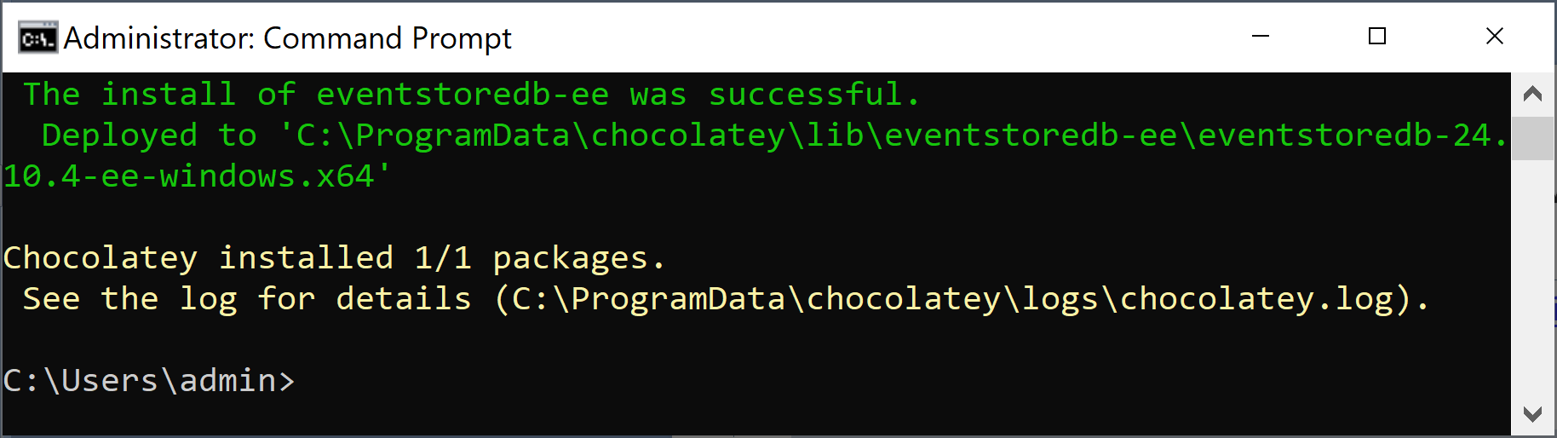
2. Install KurrentDB on Windows
https://docs.kurrent.io/server/v24.10/quick-start/installation.html
choco source add -n eventstore-eventstore -s https://nuget.eventstore.com/eventstore/v2/
choco install eventstoredb-ee -s eventstore-eventstore --version 24.10.4

Slide 9
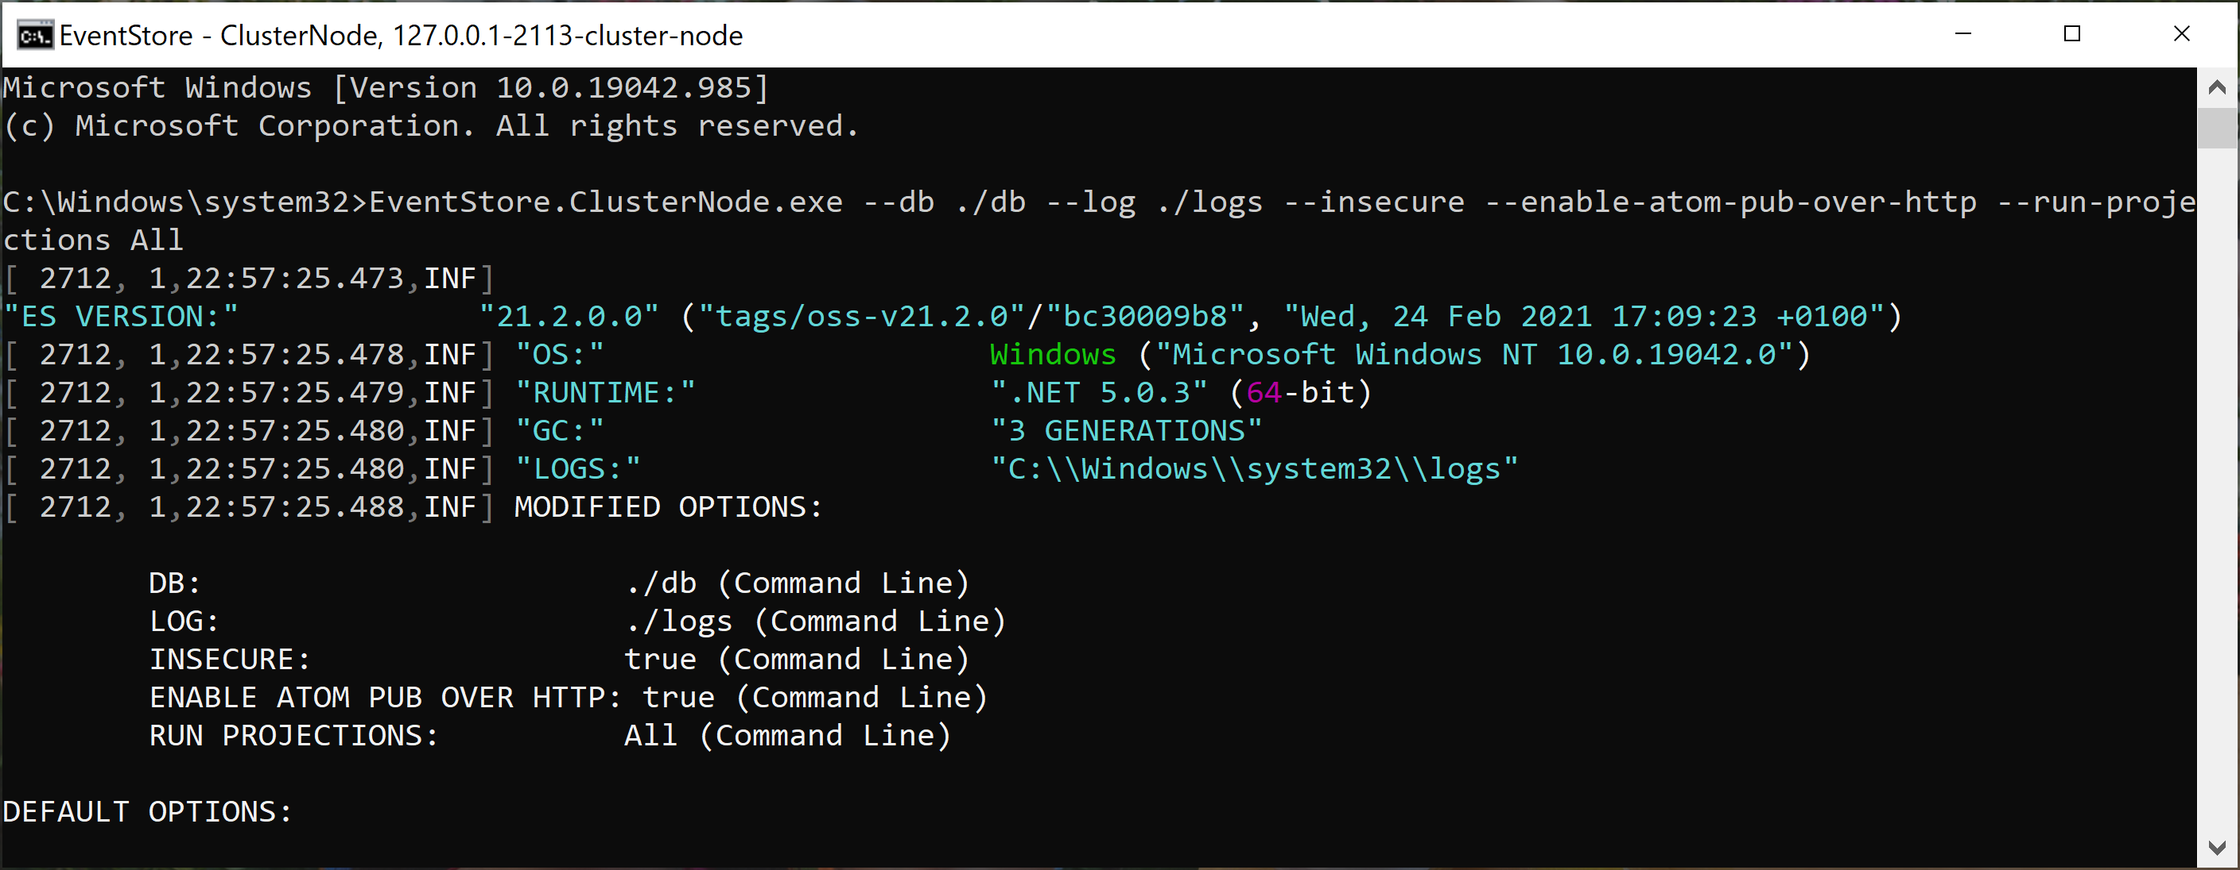
3. Start KurrentDB
EventStore.ClusterNode.exe --db ./db --log ./logs --insecure --enable-atom-pub-over-http --run-projections All
--insecure: disable TLS.
--enable-atom-pub-over-http: enable Stream browser.
--run-projections All: enable Projections.

Slide 10
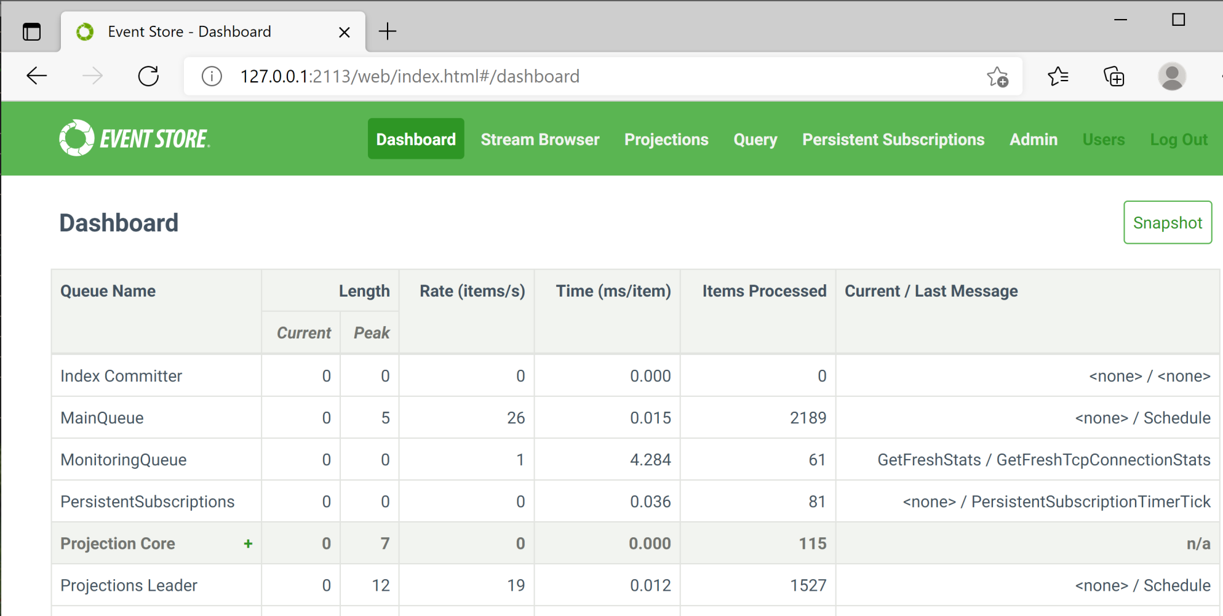
4. Connect to KurrentDB
http://127.0.0.1:2113

Slide 11
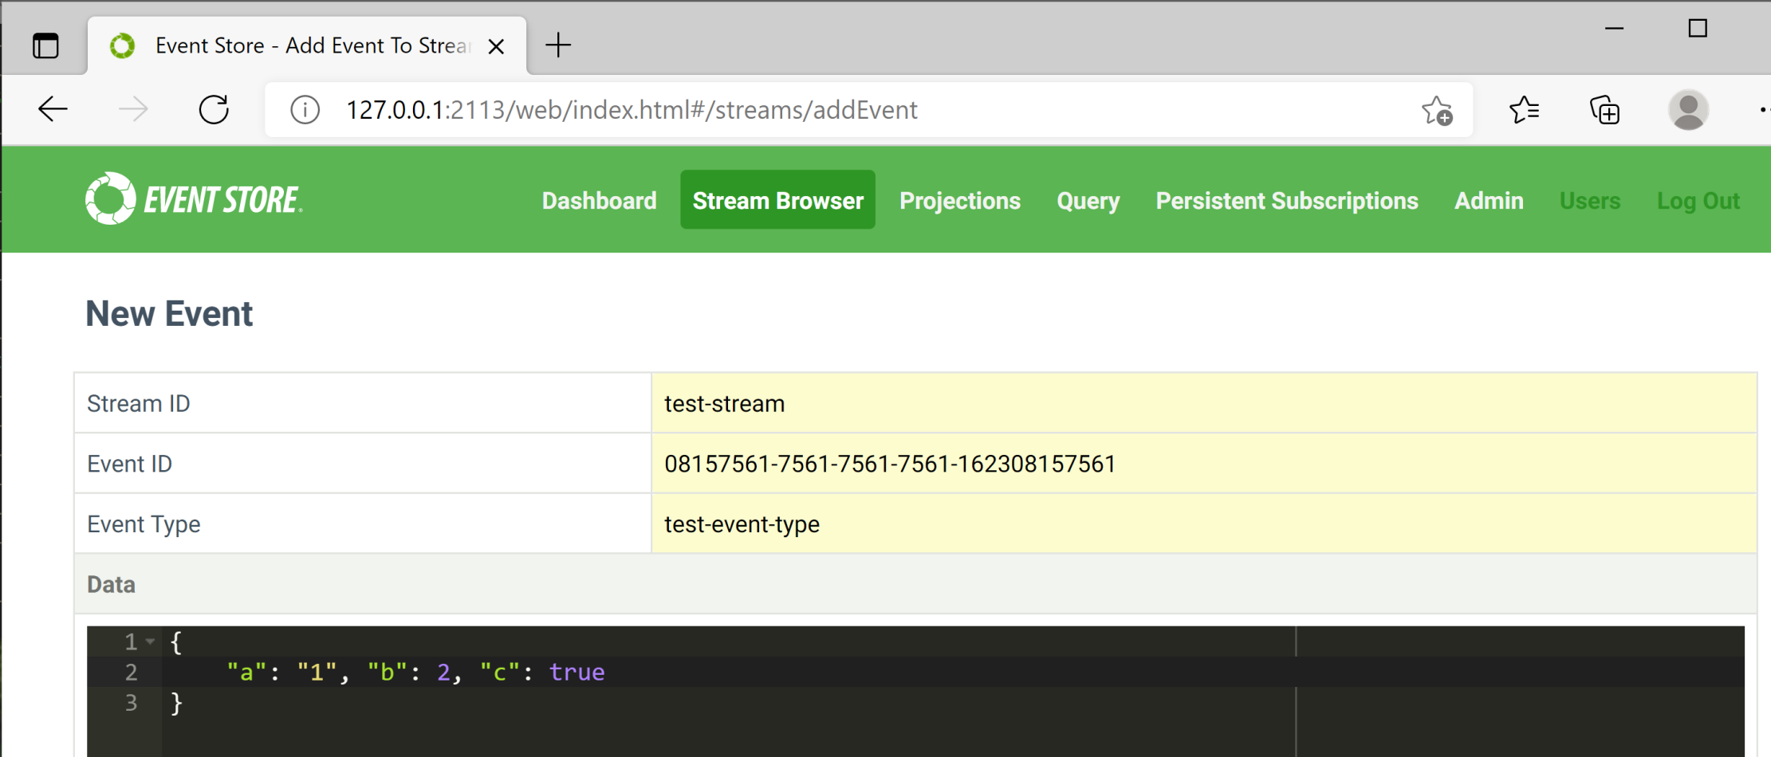
5. Write Events
http://127.0.0.1:2113/web/index.html#/streams/addEvent

Slide 12


Slide 13
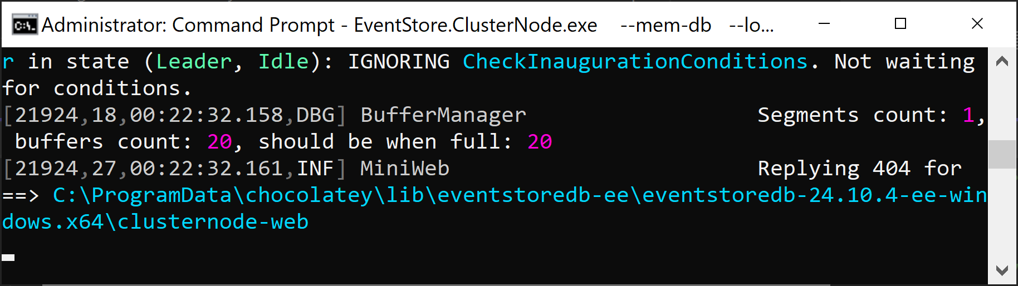
1. Start a Testing Instance
EventStore.ClusterNode.exe --mem-db --log ./logs --insecure --enable-atom-pub-over-http --run-projections All --ext-ip 0.0.0.0

Slide 14
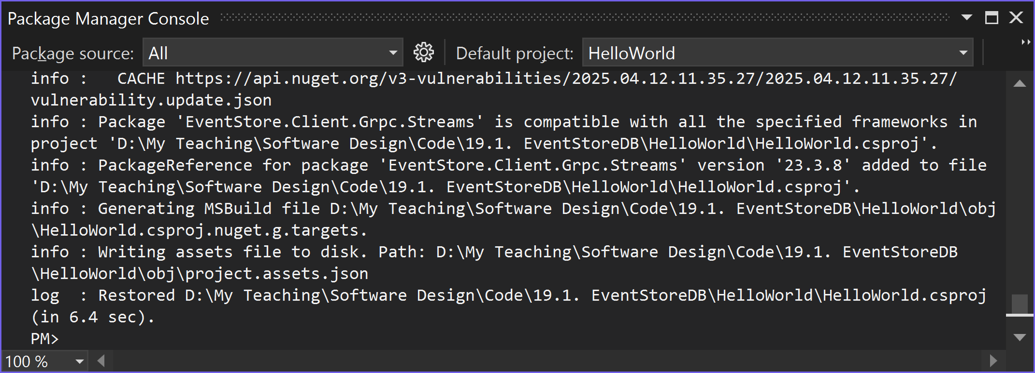
2. Install the .NET client API
dotnet add package EventStore.Client.Grpc.Streams

Slide 15
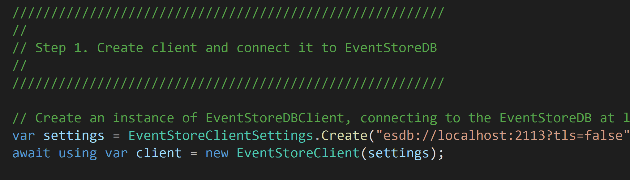
3. Connect to KurrentDB
https://github.com/kurrent-io/EventStoreDB-From-Scratch-Dotnet/tree/main

Slide 16
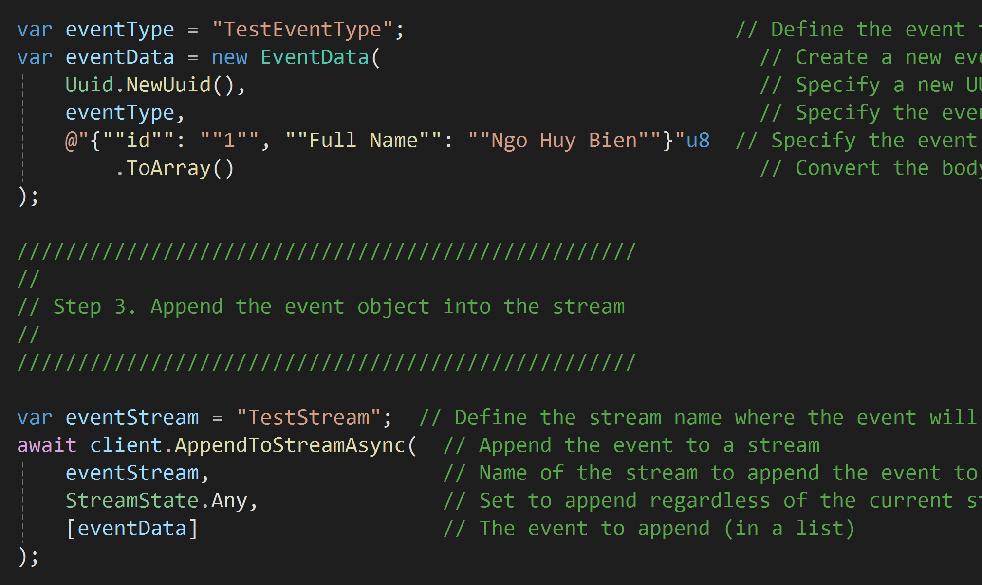
4. Append Data

Slide 17
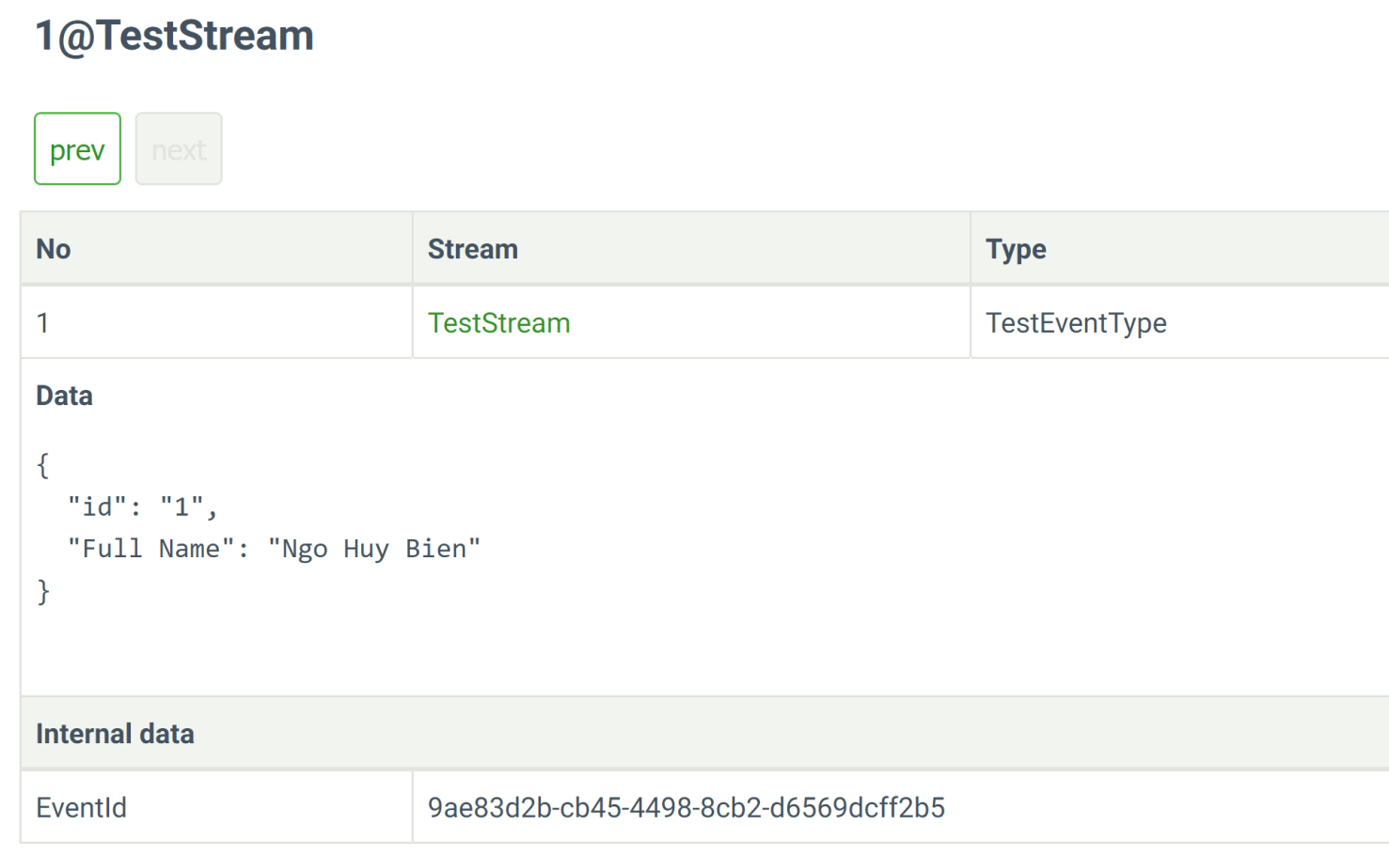
5. Verify Appended Data
http://127.0.0.1:2113/web/index.html#/streams/TestStream/1

Slide 18
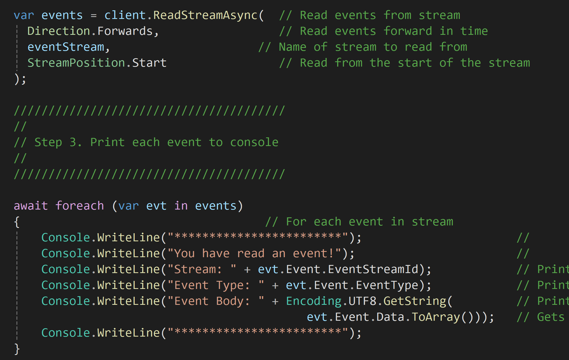
6. Read Events

Slide 19
More Samples
https://github.com/kurrent-io/EventStore-Client-Dotnet/tree/master/samples
https://github.com/kurrent-io/KurrentDB-Client-Java
https://github.com/kurrent-io/KurrentDB-Client-NodeJS

Slide 21
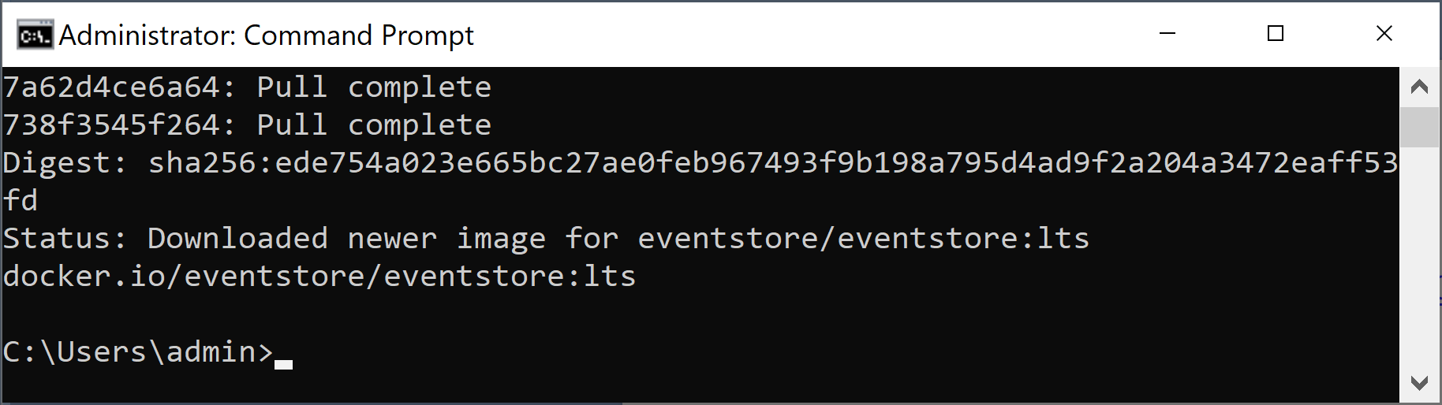
1. Pull Docker Image
https://hub.docker.com/r/eventstore/eventstore/tags
docker pull eventstore/eventstore:lts

Slide 22
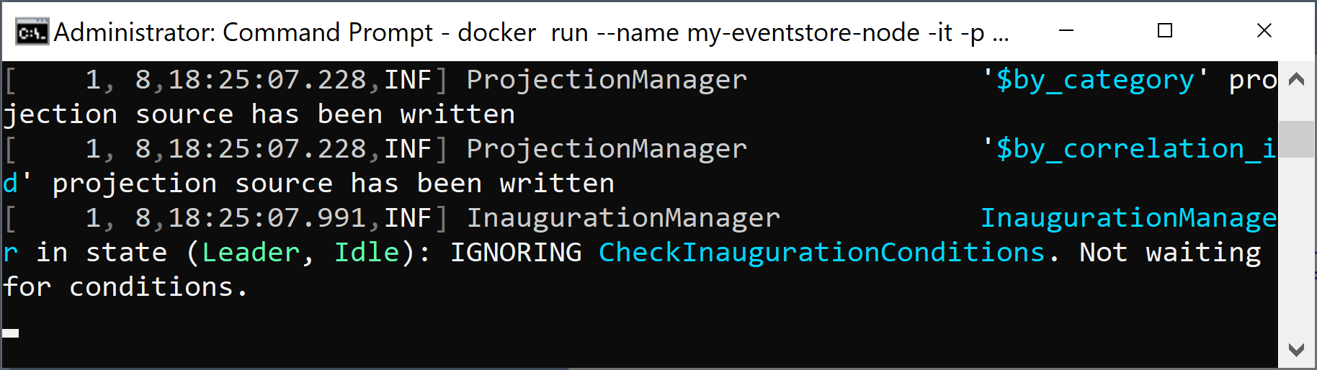
2. Run the Docker Image
https://developers.eventstore.com/server/v20.10/installation.html#run-with-docker
docker run --name my-eventstore-node -it -p 2113:2113 -p 1113:1113 eventstore/eventstore:lts --insecure --run-projections=All --enable-atom-pub-over-http

Slide 23
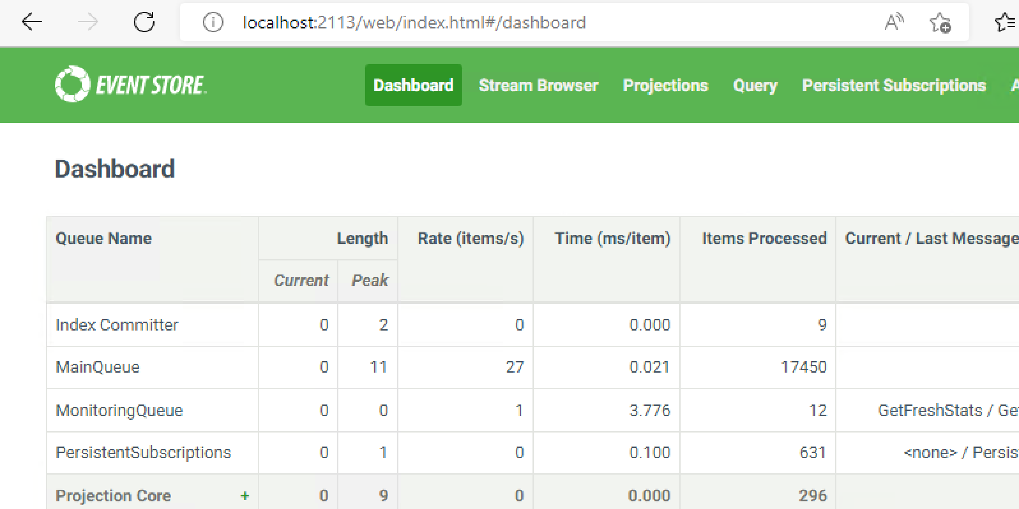
3. Connect to KurrentDB
http://localhost:2113/

Slide 25
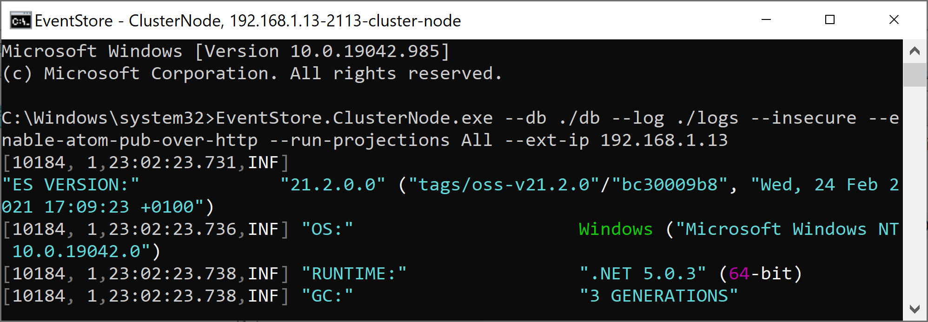
1. Allow Remote Connections
EventStore.ClusterNode.exe --db ./db --log ./logs --insecure --enable-atom-pub-over-http --run-projections All --ext-ip 192.168.1.19 --enable-external-tcp
EventStore.ClusterNode.exe --db ./db --log ./logs --insecure --enable-atom-pub-over-http --run-projections All --ext-ip 0.0.0.0 --enable-external-tcp

Slide 26
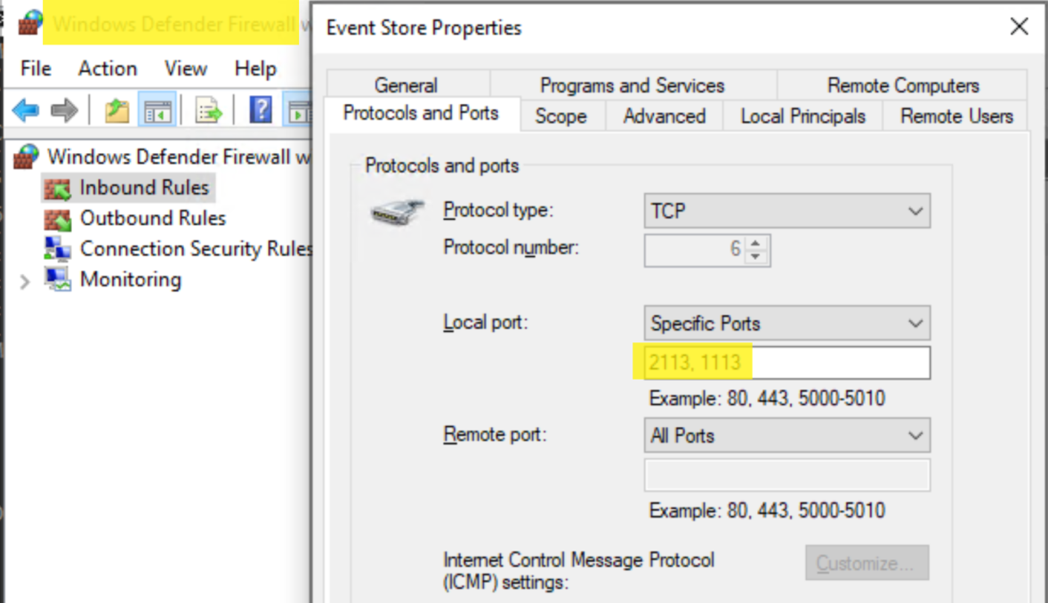
2. Open 2113, 1113 Ports

Slide 27
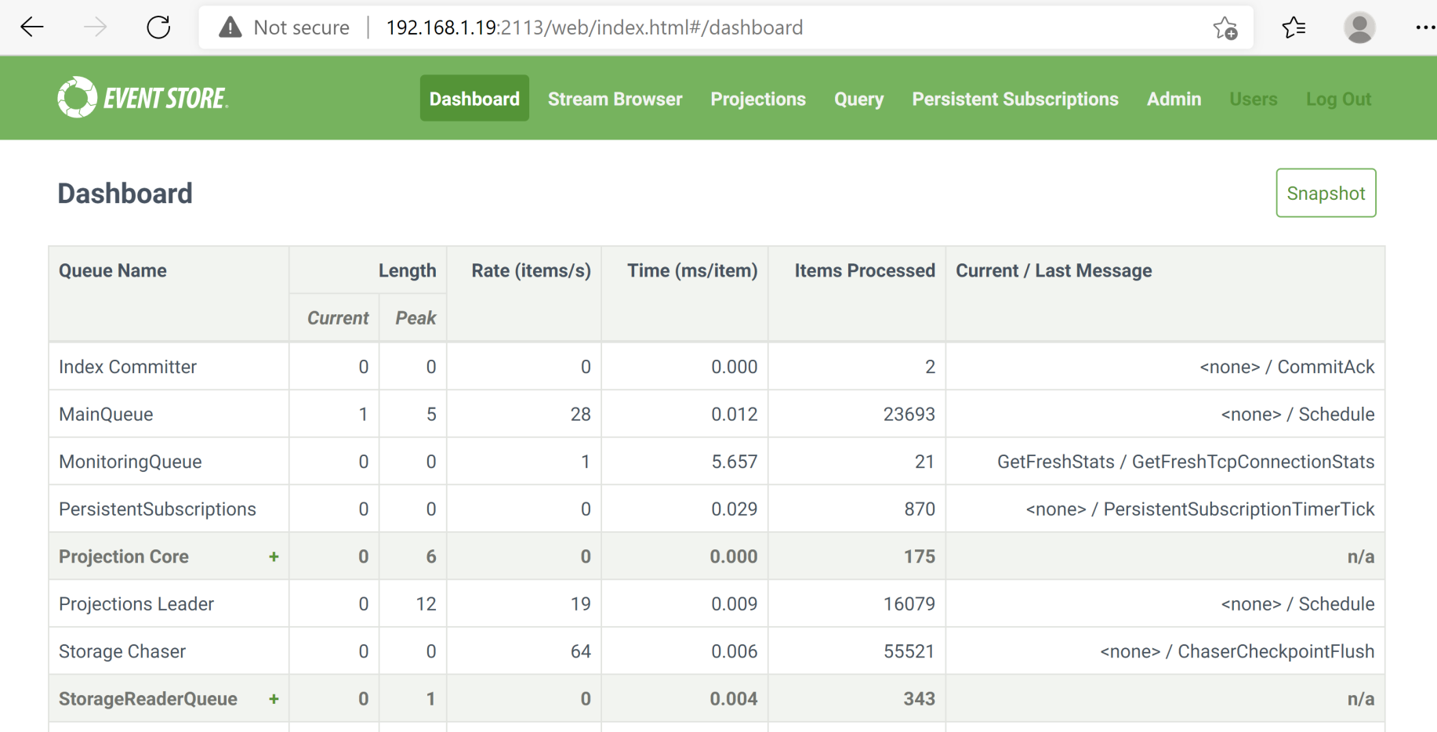
3. Connect to the Remote Instance
http://192.168.1.19:2113

Slide 29
Install KurrentDB on Ubuntu

Slide 30

Thank You & See You Again

